Slide 1
IBM DATA SCIENCE PROFESIONAL CAPSTONE PROJECT
WEN YIDA
2019-12-23
Notes:
Author notes: <please delete these instructions before presenting>
This is the IBM Security Default Template for both internal and external use. It’s aspect ratio is 16:10 and measures 10 x 6.25”. This template was created in Microsoft PowerPoint 365 Pro Plus 2016.
Template files (saved with the file extension .potx) contain slide designs and customized layouts and are stored in your Microsoft templates folder*
To save your new template as your default template for future use:
Click “File / Save as” and choose “PowerPoint template (.potx) from the pull down menu”
Rename file to, “Blank.potx” and click “Save” (file will then be stored to the default template location)
Themes provide a complete slide design that can be applied to your existing presentation, including background designs, font styles, colors, and layouts
To save your new template’s theme file; click “View / Slide Master / Themes”
On the Themes pull down menu, select, “Save Current Theme”
This new Theme file is how you apply the new template design to your existing presentations
For more information, visit: Office.com / PowerPoint / Support
Copy your existing source slides in slide sorter view
Paste special by right-clicking in slide sorter view of destination file or template
Select “Keep source formatting”
This helps to ensure your slides retain their existing styles
Each slide needs to be adjusted by doing the following in “Normal view”
Select body content except title and footer by (Control “A”; then select title and footers while holding shift key)
Cut remaining selected body content (Control “X”)
Reset slide layout using new template layouts
Paste slide content back onto slide (Control “V”)
Learn more about using templates, visit: Office.com / PowerPoint / Support

Slide 2
Background: Immigration to Canada
70% from Europe before 1960s
Universal point system in 1967
64% from non-European regions in the 1970s
Business Immigration Program in 1978
60% from Asia since 1980s

Slide 3

Quick Fact: Toronto
Toronto – Pollution 6.1 million by 2019
10.8% of the city’s population, or 658 K(*) are Chinese, based on 2016 Census -> Big Market Share
Location is key to run a successful Chinese Cuisine Restaurant.
Source:http://worldpopulationreview.com/world-cities/toronto-population/

Slide 4
About this project
This is the capstone project for IBM Data Science Professional Certificate.
Due to very high market share, it is a very good opportunity to open an Chinese Cuisine restaurant in Toronto.
This project is trying to find out the ideal location for open Chinese Cuisine restaurant in Toronto:
Neighborhoods list in Canada Toronto (week 3, from Wikipedia);
Use Foursquare API to get list of venues and coordinates;
Coordinates of Toronto Neighborhoods；
Use K-means Clustering to group by Toronto Neighborhoods by Chinese Cuisine restaurants.
Visualize the map and data by using Folium taught during visualization class.
Target Audience:
Entrepreneurs
Joint Venture or Private Equity who has interests on acquiring Chinese restaurants.

Slide 5
Data
To solve this problem, we will need below data:
List of neighborhoods in Toronto, Canada;
Latitude and Longitude of these neighborhoods;
Venue data related to Chinese restaurants;
Neighborhoods that are good to open an Chinese Restaurants.
EXTRACTING THE DATA
The list of Toronto neighborhoods in Wikipedia;
Latitude and Longitude data of neighborhoods via CSV provided during Week 3;
Foursquare API to get venue information related to Chinses restaurants.

Slide 6
K-MEANS Clustering
K-means clustering algorithm identifies k number of centroids, and then
allocates every data point to the nearest cluster while keeping the
centroids as small as possible.
For this project clustered the neighborhoods in Toronto into 3
clusters (Cluster 0, Cluster 1, Cluster 2)
Clustering based on their frequency of occurrence for “Chinese food”. Based
on the results (the concentration of clusters).
Cluster 0: Neighborhoods with the less number of Chinese Restaurants
Cluster 1: Neighborhoods with the middle size of Chinese restaurants.
Cluster 2: Neighborhoods with a more number of Chinese restaurants

Slide 7
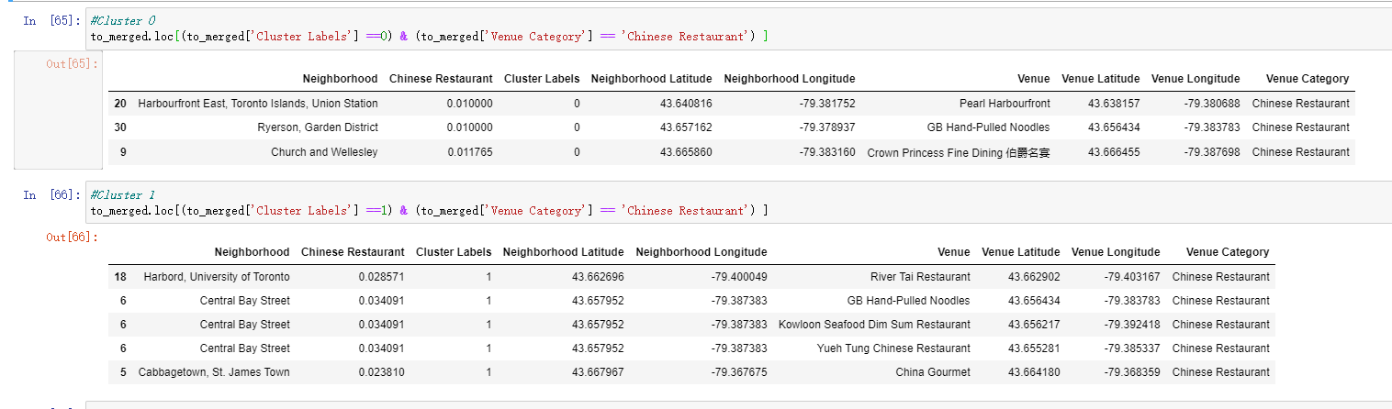
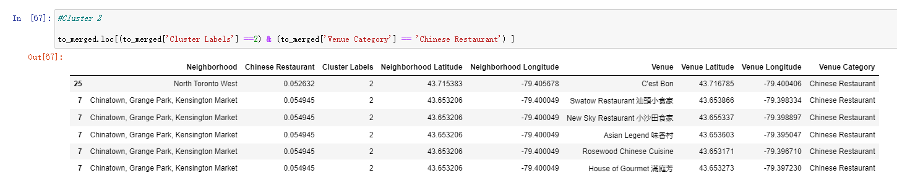
Result and Visualization

Slide 8
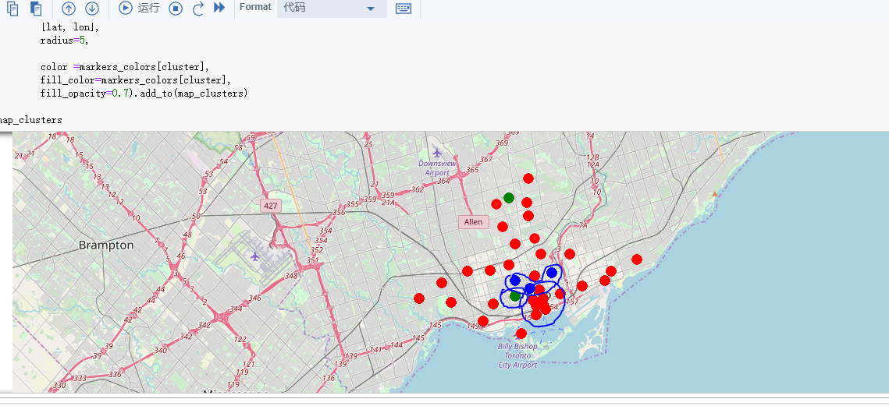
Result and Visualization

Slide 9
Conclusion
There are a lot of Chinese Restaurants in Toronto already;
Most Chinese restaurants are in Chinatown, Grange Park, Kensington Market (Cluster 2).
And in Cluster 1 areas which are more concentrated on Central Bay Street.
In cluster 0 area, there are less Chinese restaurants. For restaurant like "Crown Princess Fine Dining 伯爵名宴", is near University of Toronto.
Therefore, if you want to open a Chinese restaurants, maybe the Church and Wellesley is a good place, since is near University of Toronto got a lots of Chinese students as customer, but less competition.
Since main customer group is university students, food should be cheaper but tasty, decoration and healthy diet(like organic) for restaurants will not be so important.

Slide 10
Notes:
Mandatory closing slide with copyright and legal disclaimers.

